Slide 1





MACHINERA
Numpy, Pandas & Scipy

Slide 2


Virtual
Environment
Setup
1.Open a folder in command prompt
2.Type-pip install virtualenv
3.Type-vitrtualenv test(here test is the name of virtual
environment)
4.Type-test\Scripts\activate(to activate the environment)

Slide 3
INSTALLING PANDAS,NUMPY & SCIPY
01
02
03
NUMPY- pip install numpy
PANDAS- pip install pandas
SCIPY- pip install scipy
Numpy is a library for the Python programming language, adding support for large, multi-dimensional arrays and matrices, along with a large collection of high-level mathematical functions to operate on these arrays it.
Pandas is a software library written for the Python programming language for data manipulation and analysis. In particular, it offers data structures and operations for manipulating numerical tables and time series.
SciPy contains modules for optimization, linear algebra, integration, interpolation, special functions, FFT, signal and image processing, ODE solvers and other tasks common in science and engineering.

Slide 4
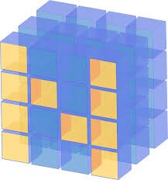


Numpy over List
List
Numpy

Slide 5
Fixed type
Why Numpy is Fast?
Int 32
00000000 00000000 00000000 00000101
[5,6,7,8,9]
Numpy
5
Lists
00000000 000000000 000000000000 00000000 0000000 000000 00000000
00000000 00000101

Slide 6
Application of Numpy
MATHEMATICS(MATLAB REPLACEMENT)
PLOTTING(MATPLOITLIB)
PANDAS
MACHINE LEARNING

Slide 7
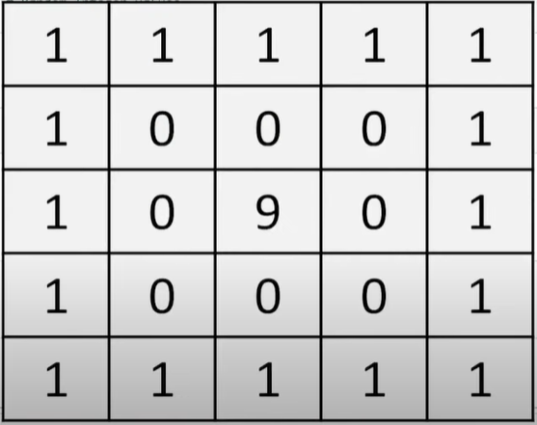
SUM

